Slide 1
arrays

Slide 2
Agenda
Arrays
Declaration
Initialization
1D Arrays
2D Arrays
3D Arrays
References

Slide 3
Arrays
An array is a data structure which stores homogeneous (similar) data items.
An array variable is used to store more than one data item of same data type at contiguous memory locations.
An array is a collection of similar kind of data elements stored in adjacent memory locations and are referred to by a single array-name.
Arrays are defined in much the same manner as ordinary variables, except that each array name must be accompanied by a size specification.

Slide 4
Arrays
The size and type of arrays cannot be changed after its declaration.
Consider to store marks of five students. They can be stored using five variables as follows:
int ml,m2,m3,m4,m5;
Now, if we want to do the same thing for 100 students in a class then one will find it difficult to handle 100 variables.
In such situations it is often convenient to place the data items into an array, where they will share the same name with a subscript.
Example:- If you want to store marks of 100 students you can create an array for it.
int marks[100];

Slide 5
Advantages & Disadvantages of Array
Advantages:
Code Optimization: Less code to the access the data.
Easy to traverse data: By using the for loop, we can retrieve the elements of an array easily.
Easy to sort data: To sort the elements of array, we need only a few lines of code.
Random Access: We can access any element randomly using the array.
Disadvantages:
Fixed Size: Whatever size, we define at the time of declaration of array, we can't exceed the limit. So, it doesn't grow the size dynamically like LinkedList.

Slide 6
Array Terminologies
Size: Total number of elements in an array
Type: Data type of declared array.
Base: Address of the first element of the array.
Index: Location or index value of array element.
Range: Value from lower bound to upper bound.
Word: Indicates the space required for an element.

Slide 7
Array Declaration
In C, you have to declare and define array before it can be used.
Declaration and definition tell the compiler the name of the array, the data type of the elements, and the size or number of elements.
When array size is given:
We can declare an array in the c language in the following way:
data-type array_name [size];
Data-type refers to the type of elements you want to store and Size specifies the number of elements.
Eg:- float mark[5];
Here, float is the data ype, mark is the array name and 5 is the size of the array.

Slide 8
Array Declaration
You can access elements of an array by indices.
Suppose you declared an array 'mark' as float mark[5];
The first element is mark[0], second element is mark[1] and so on.
Arrays have 0 as the first index not 1.
In this example, mark[0] is the first element.
If the size of an array is n, to access the last element, [n-1] index is used.
In this example, mark[4] is the last element.
Suppose the starting address of mark[0] is 2120. Then, the next address, mark[1], will be 2124, address of mark[2] will be 2128 and so on. Its because the size of a float is 4 bytes.

Slide 9
Array Declaration
Suppose you declared an array of 10 elements.
Lets say, int testArray[10];
You can use the array members from testArray[0] to testArray[9].
If you try to access array elements outside of its bound, lets say testArray[12], the compiler may not show any error.
However, this may cause unexpected output (undefined behavior).

Slide 10
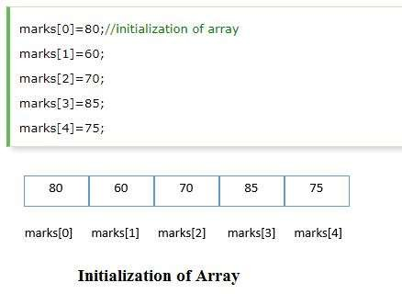
Array Initialization
A simple way to initialize array is by index.
Array index starts from 0 and ends with [size-1]
Syntax:- datatype array-name[ size ] = {val 1, val 2, .......val n};
Eg:- a[5]= {10,20,30,40,50}
marks[5]={80,60,70,85,75}

Slide 11
Array Initialization
It is possible to initialize an array during declaration.
Eg:- int mark[5] = {9,4,6,3,5};
Another method of initialize array during declaration is
Eg:- int mark[ ] ={9,4,6,3,5};
Here,
mark[0] = 9
mark[1] = 4
mark[2] = 6
mark[3] = 3
mark[4] = 5
Other examples
int digits[10] = {1,2,3,4,5,6,7,8,9,10};
int digits[ ] = {1,2,3,4,5,6,7,8,9,10};

Slide 12


Array Initialization
We can initialize the c array at the time of declaration.
In such case, there is no requirement to define size. So it can also be written as the following code.

Slide 13
One-dimensional Array (1D)
A list of item can be given one variable name using only one subscript and such a variable is called a a single subscripted variable or a one dimensional array.
The Syntax for an array declaration is:
type variable-name[size];
Example:- float height[50]; int groupt[10]; char name[10];
The type specifies the type of the element that will be contained in the array, such as int, float, or char and the size indicates the maximum number of elements that can be stored inside the array.

Slide 14
One-dimensional Array (1D)
Now as we declare a array int number[5];
Then the computer reserves five storage locations as the size of the array is 5 as show below.
The statement, number[5]={35,20,40,57,19}; initializes and stores values inside the array.
Reserved Space Storing values after Initialization
number[0] number[1] number[2] number[3] number[4]
number[0] number[1] number[2] number[3] number[4]
35
20
40
57
19

Slide 15
Initialization of one dimensional array
After an array is declared, its elements must be initialized.
In C programming an array can be initialized at either of the following stages:
At compile time
At run time

Slide 16
Compile Time Initialization
The general form of initialization of array is:
type array-name[size] ={list of values};
The values in the list are separated by commas.
For example: int number[3] = {0,5,4};
This statement will declare the variable 'number' as an array of size 3 and will assign the values to each elements.
If the number of values in the list is less than the number of array elements, then, only that many elements will be initialized.
Remaining elements will be set to '0' automatically.
If we have more initializers than the size, the compiler will produce an error.

Slide 17
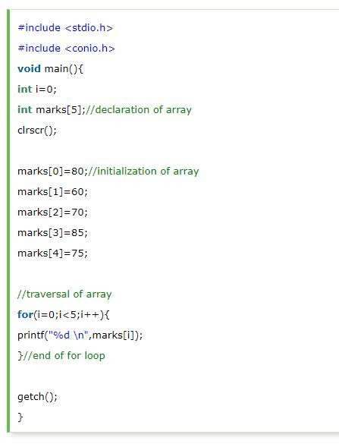
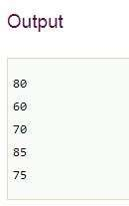
Example Array Program 1

Slide 18
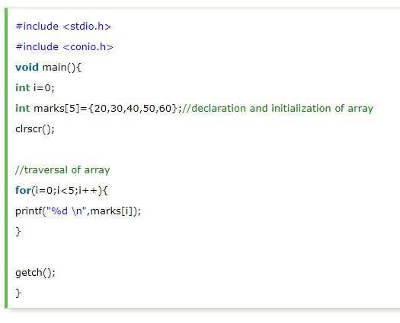
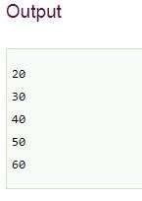
Example Array Program 2

Slide 19
Run time initialization
An array can also be explicitly initialized at run time.
For example consider the following segment of a c program.
for(i=0;i<10;i++)
{
scanf(“%d”, &x[i]);
}
In the run time initialization of the arrays, looping statements are almost compulsory.
Looping statements are used to initialize the values of the arrays one by one using assignment operator or through the keyboard by the user.

Slide 20
Example Array Program 3
Program:
#include<stdio.h>
void main()
{
int array[5];
printf(“Enter 5 elements in the array: \n”);
for(i=0;i<5;i++)
{
scanf(“%d”, &array[i]);
}
printf(“Elements in the array are: \n”);
for(i=0;i<5;i++)
{
printf(“Element stored at a[%d]=%d \n”, i, array[i]);
}
Output:
Enter 5 elements in the array:
23 45 32 25 45
Elements in the array are:
Element stored at a[0]:23
Element stored at a[1]:45
Element stored at a[2]:32
Element stored at a[3]:25
Element stored at a[4]:45

Slide 21
Example of One Dimensional Array Program 4
/*Write a program to get n numbers and find out sum and average of numbers*/
#include<stdio.h>
void main()
{
int a[10],i,n; //array of size 10
float avg,sum=0;
printf(“Give the values of n”);
scanf(“%d”,&n);
for(i=0;i<n;i++)
{
printf(“Give number\n”);
scanf(“%d”,&a[i]);
sum=sum+a[i];
}
avg=sum/n;
printf(“Array elements are :\n);
printf(“\nSum=%f Average= %f\n”,sum, avg);
}

Slide 22
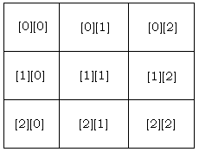
Two-dimensional Arrays (2D)
The simplest form of multidimensional array is two dimensional array.
The two dimensional array in C language is represented in the form of rows and columns, also known as matrix.
It is also known as array of arrays or list of arrays.
A two dimensional array is a list of one dimensional arrays.
The two dimensional, three dimensional or other dimensional arrays are also known as multidimensional arrays.
Syntax of declaration of a two dimensional array
type array-name[row_size][col_size];
Illustration of a 3 X 3 Array

Slide 23
Two-dimensional Arrays (2D)
A two-dimensional array can be considered as a table which will have m number of rows and n number of columns.
It can be declared as int a[m][n];
A two-dimensional array a, which contains three rows and four columns i.e., a[3][4], can be shown as follows.
Column 0 Column 1 Column 2 Column 3
Row 0
Row 1
Row 2
a[0][0] | a[0][1] | a[0][2] | a[0][3]
a[1][0] | a[1][1] | a[1][2] | a[1][3]
a[2][0] | a[2][1] | a[2][2] | a[2][3]

Slide 24
Initializing Two-Dimensional Arrays
Multidimensional arrays may be initialized by specifying bracketed values for each row.
Following is an array with 3 rows and each row has 4 columns.
int a[3][4] = {
{0,1,2,3},
{4,5,6,7},
{8,9,10,11}
};
The nested braces, which indicate the intended row, are optional.
The following initialization is equivalent to the previous example
int a[3][4] = {0,1,2,3,4,5,6,7,8,9,10,11};

Slide 25
Initializing Two-Dimensional Arrays
int table[2][3] = { 1,2,3,4,5,6 };
Or
int table[2][3] = {
{1,2,3},
{4,5,6} };
It means that element:
table [ 0][0] = 1;
table [ 0][1] = 2;
table [ 0][2] = 3;
table [ 1][0] = 4;
table [ 1][1] = 5;
table [ 1][2] = 6;

Slide 26
Accessing Two-Dimensional Array Elements
Every element in the array is identified by an element name of the form a[i][j], where ‘a’ is the name of the array, and ‘i’ and ‘j’ are the subscripts that uniquely identify each elements in ‘a’.
Thus, an element in a two-dimensional array is accessed by using the subscripts. i.e., row index and column index of the array.
For Example:- int val = a[2][3];
The above statement will take the 4th element from the 3rd row of the array.

Slide 27
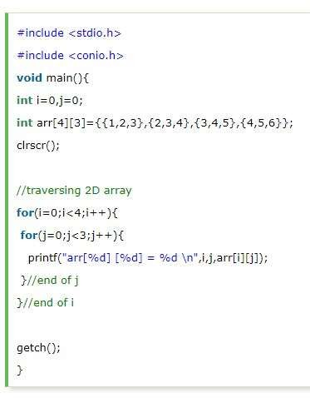
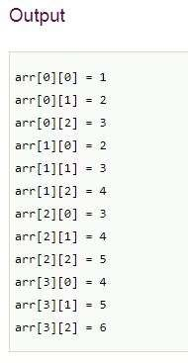
Two dimensional array example Program1

Slide 28
Two-Dimensional Arrays program 2
Output:
a[0][0]: 0
a[0][1]: 0
a[1][0]: 1
a[1][1]: 2
a[2][0]: 2
a[2][1]: 4
a[3][0]: 3
a[3][1]: 6
a[4][0]: 4
a[4][1]: 8
#include<stdio.h> int main()
{
int a[5][2]={{0,0},{1,2},{2,4},{3,6},{4,8}};
int i,j; for(i=0;i<5;i++)
{
for(j=0;j<2;j++)
{
printf(“a[%d][%d] = %d\n”,i,j,a[i][j]);
}
}
return 0;
}

Slide 29
Two-Dimensional Arrays program 3
/*Write a program to read 3*3 matrix and find maximum number*/
#include<stdio.h> #include<conio.h>
void main()
{
int a[3][3],i,j,max;
clrscr();
printf(“Enter the elements of the matrix\n”);
for(i=0;i<3;i++)
{
for(j=0;j<3;j++)
{
printf(“a[%d][%d]= “,i,j);
scanf(“%d”,&a[i][j]);
}
printf(“\n”);
}
max=a[0][0];
for(i=0;i<3;i++)
{
for(j=o;j<3;j++)
{
if(max<a[i][j])
max=a[i][j];
}
}
printf(“Max number is = %d”, max);
getch();
}

Slide 30
OUTPUT
Enter matrix row wise
a[0][0]=3
a[0][1]=6
a[0][2]=7
a[1][0]=4
a[1][1]=5
a[1][2]=8
a[2][0]=0
a[2][1]=9
a[2][2]=2
Max number is = 9

Slide 31
Transpose of a Matrix Program 4
#include<stdio.h>
main()
{
int mat[10][10],temp[10][10],r,c,i,j;
printf(“Enter the rows and col of the matrix:\n”);
scanf(“%d%d”,&r,&c);
printf(“Enter the elements of matrix”);
for(i=0;i<r;i++)
{
for (j=0;j<c;j++)
scanf(“%d”,&mat[i][j]);
}
for(i=0;i<r;i++)
{ for (j=0;j<c;j++)
temp[j][i]=mat[i][j];
}
printf(“Transpose of the matrix\n”);
for(i=0;i<c;i++)
{ for (j=0;j<r;j++)
printf(“%d\t”,temp[i][j]);
printf(“\n”);
}
}
OUTPUT
Enter the rows and col of the matrix
3 3
Enter the elements of the matrix
2 3 5
7 8 9
6 3 1
Transpose of the matrix
2 7 6
3 8 3
5 9 1

Slide 32
Sum of 2 matrices Program 5
#include<stdio.h>
int main()
{
int r,c,a[50][50],b[50][50],sum[50][50],i,j;
printf("\t\n Multi-dimensional array"); printf("\n Enter the no.of rows:"); scanf("%d",&r);
printf("\n Enter the no. of cols:"); scanf("%d",&c);.
printf("\nEnter elements of matrix A");
for(i=0;i<r;++i)
for(j=0;j<c;++j)
{
printf("\n a[%d][%d]:",i+1,j+1);
scanf("%d",&a[i][j]);
}
printf("\nEnter elements of matrix B");
for(i=0;i<r;++i)
for(j=0;j<c;++j)
{
printf("\n b[%d][%d]:",i+1,j+1);
scanf("%d",&b[i][j]);
}

Slide 33
printf("\n Addition of matrix");
for(i=0;i<r; i++)
{
for(j=0;j<c;j++)
sum[i][j]=a[i][j]+b[i][j];
}
for(i=0;i<r;i++)
{
printf("\n");
for(j=0;j<c;j++)
{
printf("\t%d",sum[i][j]);
}
return 0;
}

Slide 34
OUTPUT
Multidimensional array
Enter the no. of rows:2
Enter the no. of cols:2
Enter elements of matrix A a[1][1]:1
a[1][2]:4
a[2][1]:6
a[2][2]:3
Enter elements of matrix B
a[1][1]:4
a[1][2]:8
a[2][1]:2
a[2][2]:11
Addition of matrix
5 12
8 14

Slide 35
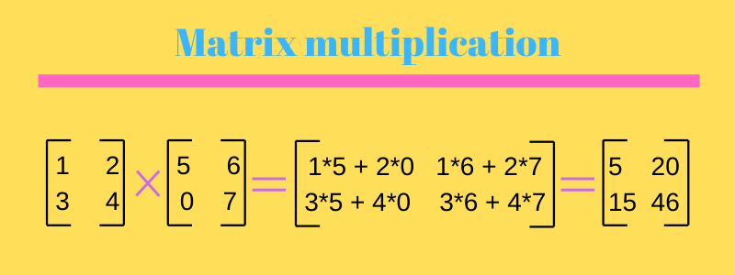
Matrix multiplication in C Program 6
Matrix multiplication in C language to calculate the product of two matrices (two-dimensional arrays).
A user inputs the orders and elements of the matrices.
If the multiplication isn't possible, an error message is displayed.
No. of columns in matrix A should be equal to No. of rows in Matrix B

Slide 36
Program:
#include <stdio.h>
int main()
{
int m, n, p, q, i, j, k;
int first[10][10], second[10][10], multiply[10][10];
printf("Enter number of rows and columns of first matrix\n");
scanf("%d%d", &m, &n);
printf("Enter elements of first matrix\n");
for (i = 0; i < m; i++)
for (j = 0; j < n; j++)
scanf("%d", &first[i][j]);

Slide 37
printf("Enter number of rows and columns of second matrix\n");
scanf("%d%d", &p, &q);
if (n != p)
printf("The multiplication isn't possible.\n");
else
{
printf("Enter elements of second matrix\n");
for (i = 0; i < p; i++)
for (j = 0; j < q; j++)
scanf("%d", &second[i][j]);

Slide 38
for (i = 0; i < m; i++)
{
for (j = 0; j < q; j++)
{
multiply[i][j]=0;
for (k = 0; k < p; k++)
{
multiply[i][j]+ = first[i][k]*second[k][j];
}
}
printf(“\n”);
}
printf("Product of the matrices:\n");
for (i = 0; i < m; i++) {
for (j = 0; j < q; j++)
printf("%d\t", multiply[i][j]);
printf("\n");
}
}
return 0;
}

Slide 39
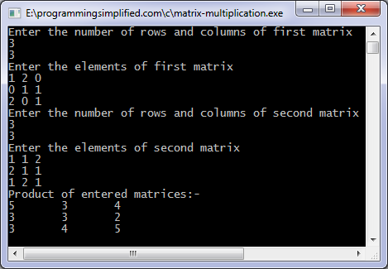
OUTPUT

Slide 40
Multi-Dimensional Arrays
C programming language supports multidimensional Arrays.
Multi dimensional arrays have more than one subscript variables.
If n>=2, then we call that array as multi-dimensional array.
Multi dimensional array is also called as matrix.
Multi dimensional arrays are called array of arrays.
For example, suppose we want to store 5 students marks information for two different exams carried out in the term for 4 different subjects, this data can be stored by using 3-dimensional array like, int marks[5][2][4];

Slide 41
Declaration of Multidimensional Array
A multidimensional array is declared using the following syntax
Syntax: - data_type array_name[d1][d2][d3][d4]....[dn];
Above statement will declare an array on N dimensions of name array_name, where each element of array is of type data_type.
The maximum number of elements that can be stored in a multi-dimensional array array_name is size1 X size2 X size3....sizeN.
For example:- char cube[50][60][30];

Slide 42
THANK YOU

